Slide 1
BSc Hons Computer Games Design and Development GDV4000 Introduction to Games Industry Practice
Action/ Shooter Games

Slide 2
Action Games
Action games typically involve challenges to dexterity – the player controlling the main character through levels where quick reflexes, and the use of appropriate attacks and defences, must be used to defeat enemies.
In the arcades, the goal would have been to accrue the most points. With the advent of the home computer and the console, the focus shifted more onto incorporating story and missions based around levels, where completing the story became more important.
Action games can be split into many sub-genres…
Shoot-em-up
FPS
Action Platformer
Shooter
Maze
Action Game
Survival
Fighter
Beat-em-up

Slide 3
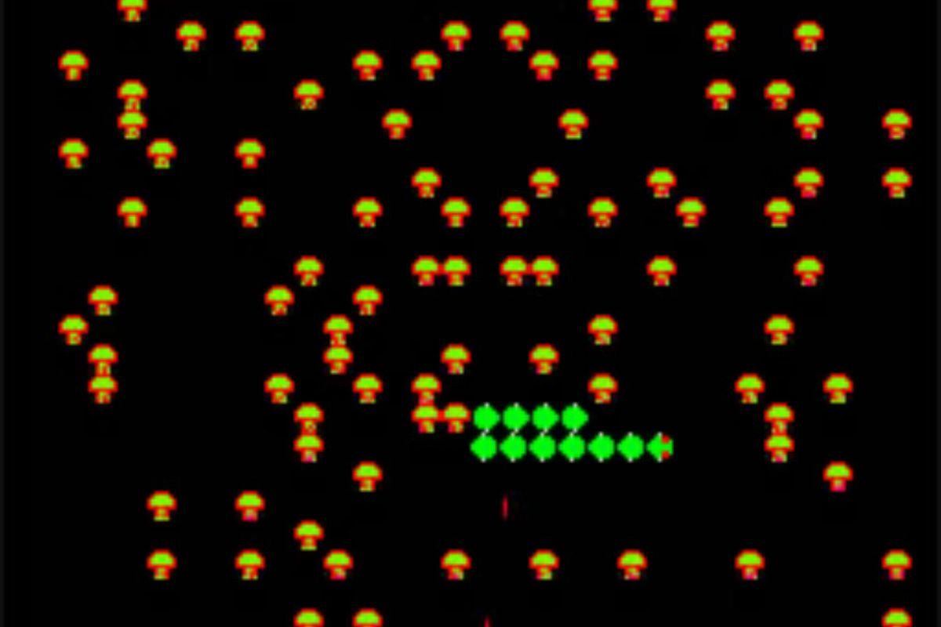
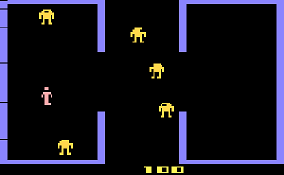
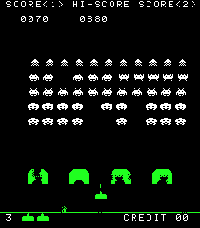
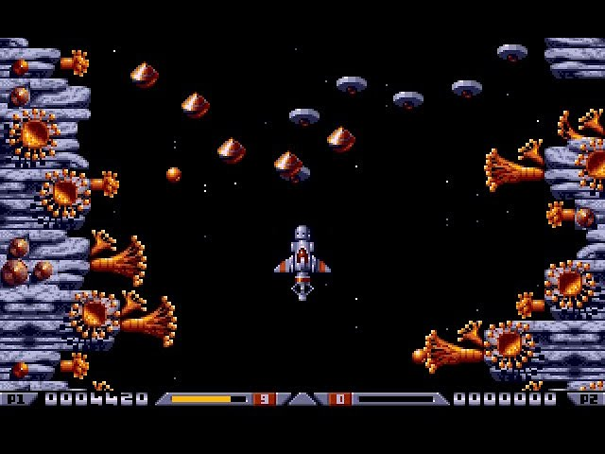
Shoot-em-ups (“shmups”)
Shoot-em-ups (AKA “shmups”, also abbreviated to “STG” in Japan) are the foundation for many of the design decisions we see in shooter-based games.
As the technology as grown and developed, the shoot-em-up genre has adapted and introduced many variations and sub-genres.
Early examples of the genre involved the player controlling a spaceship, on a single screen, attacking a range of enemies. “Space Invaders” is an example of a “fixed shooter”, where the player has a limited range of movement (left, right, up/down), and the enemies attack from a pre-defined direction.
An interesting overlap of genres: Early shoot-em-ups had the player control a spaceship or a vehicle, but this doesn’t have to be the case. Games such as “Bezerk” featured a human main character, but there could be a case made for this being classified as a Run-and-Gun.
Berzerk© Atari
Centipede © Atari
Space Invaders © Taito
Xenon2: Megablast © The Bipmap Brothers

Slide 4
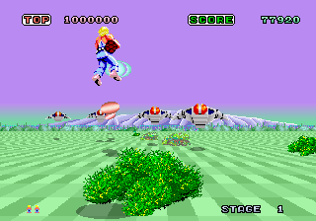
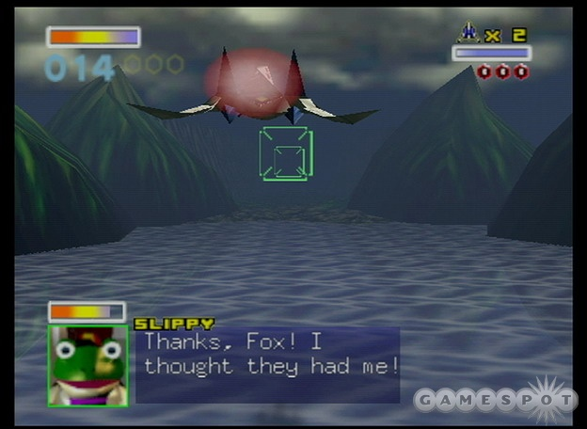
Shoot-em-ups (“shmups”)
Rail Shooters involve the player moving through a 2D or 3D environment, but the movement is automatic and follows a pre-defined path where the player has little control.
However, the mechanics can allow the players control - lateral movement (such as Space Harrier), or to rotate the point-of-view (Doom3 on Mobile).
Rail shooters can be ideally suited to mobile platforms, given the inherent restrictions on movement which can be utilised effectively with touch-based interfaces.
Space Harrier © Sega
Starfox 64 © Nintendo

Slide 5
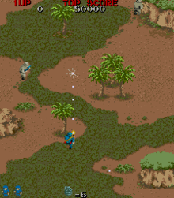
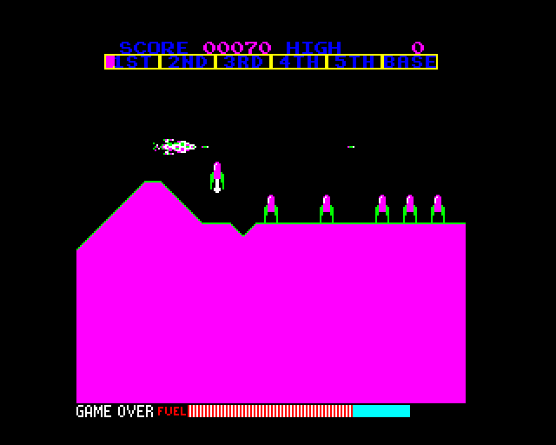
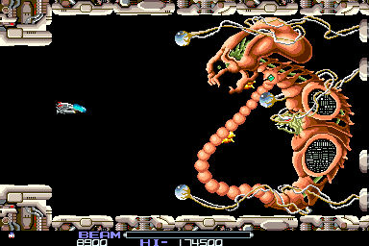
Shoot-em-ups (“shmups”)
Horizontal/Vertical scrolling shoot-em-ups share similarities to rail shooters in so much as the player is being led on a pre-defined path.
Levels proceed horizontally or vertically, with enemies and challenges increasing in difficulty, along with more powerful weapons. The level would typically end with an end-of-level boss, framed as a set-piece. This build-up to an end-of-level confrontation is something we see in a lot of genres.
Core mechanics associated with this genre are typically movement (up, down, left, right), speed boosts, fire, and a “secondary fire”.
“Secondary fire” often involve firing a secondary, more powerful weapon – typically resources are limited, as opposed to primary fire with infinite resources.
Scramble © Konami
Commando © Capcom
R-Type © Irem
Start
R-Type level 1
End of Level Boss

Slide 6
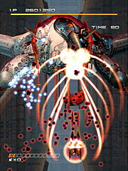
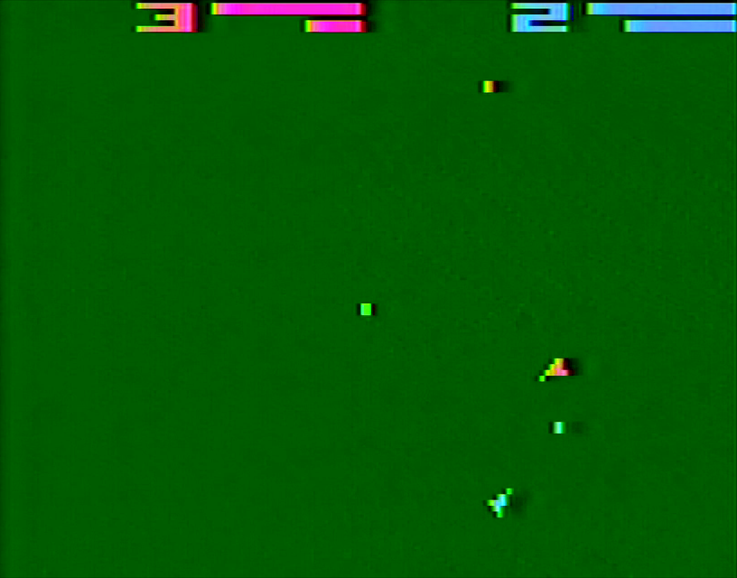
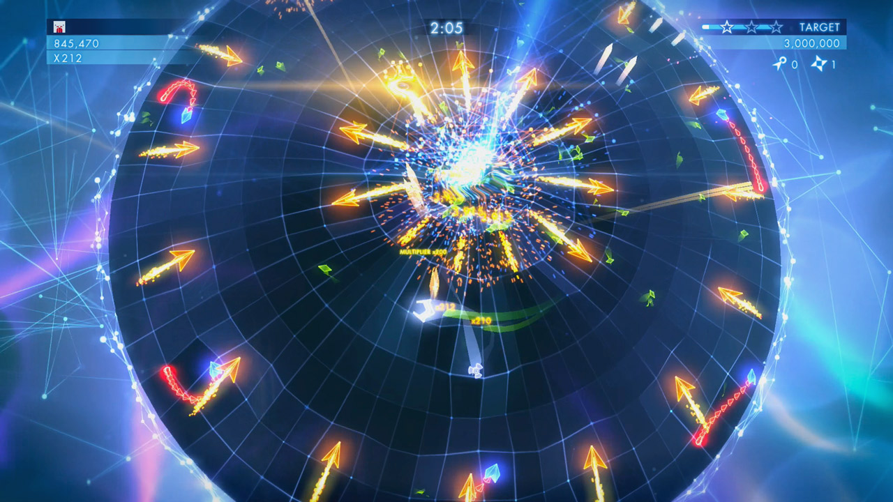
Shoot-em-ups (“shmups”)
Bullet-hell shoot-em-ups developed as a response to increasing competition from 3D games, which emerged from improved technology.
Bullet-hell games built on the core mechanics of horizontal and vertical scrolling shoot-em-ups, but with a greater focus on intensifying the number of enemies and projectiles.
From the perspective of marketing, Bullet-hell games generally appeal to a small, core fan-base of the shooter genre, as the difficulty level was pitched too high for the broader mainstream audience.
Some classic examples are Ikaruga and Geometry Wars, the latter being a multi-directional shooter which introduces player rotation as a mechanic (much like SpaceWar!)
SpaceWar © Atari
Ikaruga © SEGA
Geometry Wars © Kuju Entertainment, Bizarre Creations, Lucid Games

Slide 7
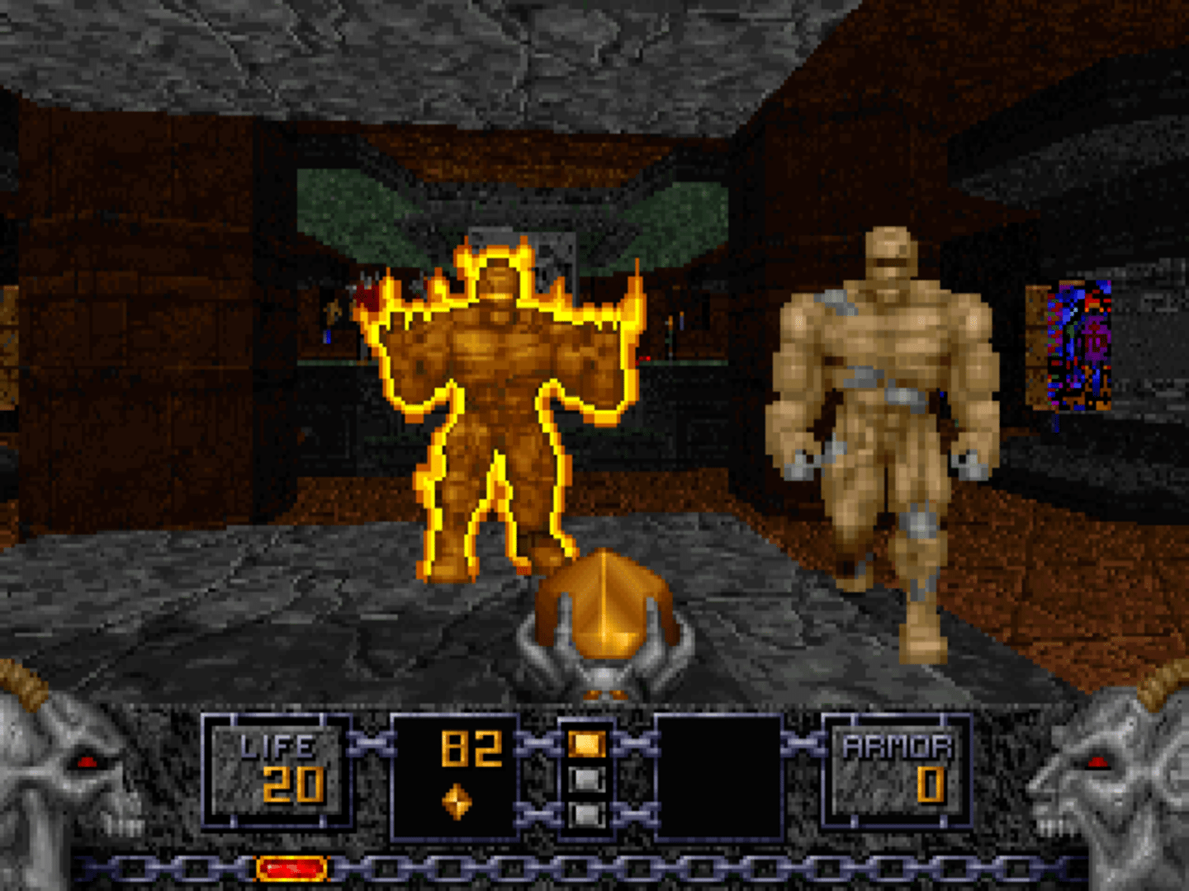
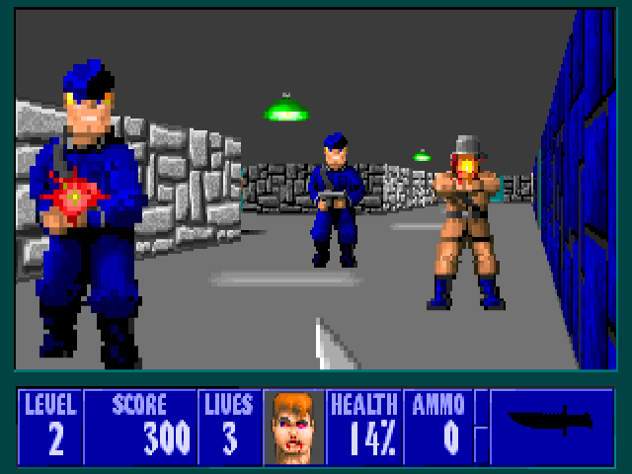
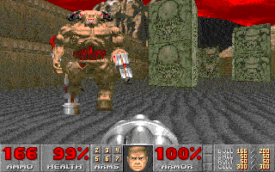
First-Person-Shooter (FPS)
The most popular shooter sub-genre (arguably the most popular gaming genre) is the First-Person-Shooter (FPS).
Early examples: Wolfenstein 3D, Doom. These games by ID Software established the basic core mechanics and level design conventions.
Early mechanics restricted the players to movement (rotation left / right, move forwards, move backwards), attacking and multi-weapon selection.
Technical limitations in the early 90’s meant that the games were not fully 3D. Objects, props, and enemies were all rendered as sprites.
Heretic © Id Software
Wolfenstein 3D © Id Software
Doom © Id Software

Slide 8
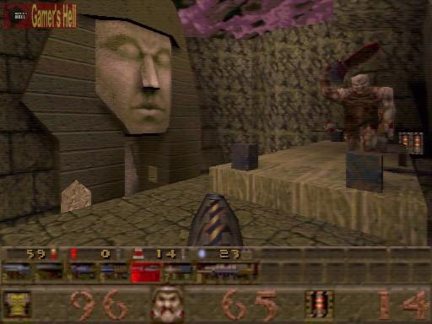
First-Person-Shooter (FPS)
The FPS genre went fully 3D with the release of Quake.
This move, with full 3D environments, meant that FPS games could be expanded beyond their initial limitations…
Characters and props could be modelled, animated and rendered as full 3D models rather than 2D sprites.
Player mechanics expanded to allow full 3D movement, including looking up and down.
This also fed into expanded level design, with overlapping map sections. The player having a full range of movement allowed for more enemy and prop positions, and different types of puzzles and challenges.
Quake © Id Software

Slide 9
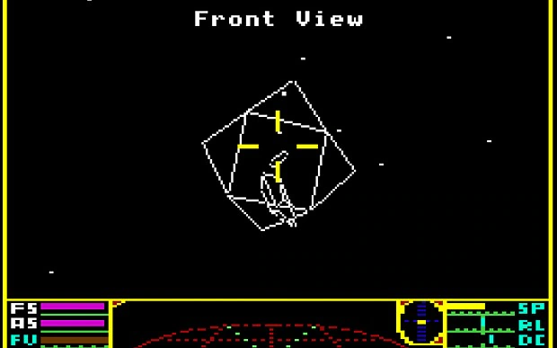
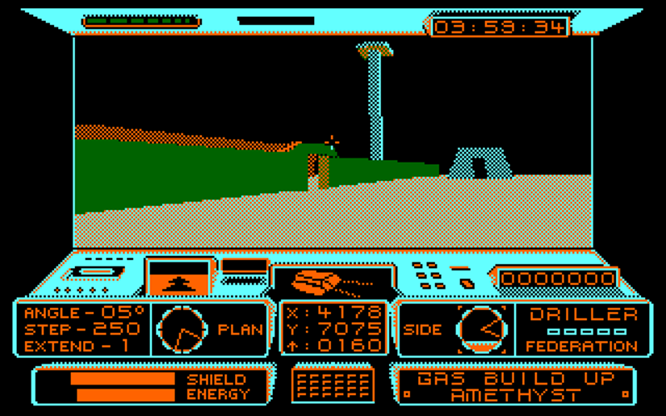
First-Person-Shooter (FPS)
Quake was not the first to present the game world in full 3D however…
Elite and early FreeScape* games rendered the world in 3D, but the technical limitations led to design choices being made over the pace and setting.
Given that it had to run on a variety of computers, limitations were built into the engine – It could not handle fractional movement. The X, Y, and Z axis had hard-coded discrete locations, which meant that game objects had to be placed at a specific distance apart or they would be missed/overshot in-game.
Elite © Acornsoft
*FreeScape was an early proprietary 3D engine developed by Incentive Software for 8-bit and 16-bit platforms that rendered shaded/ textured 3D worlds.
Driller © Incentive Software

Slide 10
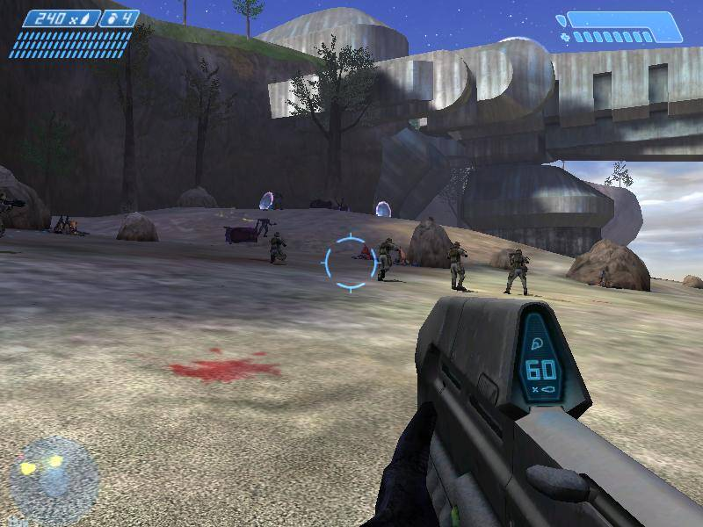
First-Person-Shooter (FPS)
The fundamental core tenants of the FPS have remained largely unchanged, but in order to remain fresh and innovative, new mechanics (stealth, wall-running), weapons, settings, and challenges have emerged.
Id Software’s games eschewed realism in favour of more flexible gameplay – and not just in the setting, be it Mars in Doom or the more Fantasy style of Heretic, their games allow the player to carry an impossibly large array of weapons on them (something we also see in many games in the Action/Adventure and RPG genres).
Later games, such as Halo, restrict the player to only two weapons – This encourages a level of tactical thinking into the game. The player has to make a decision based on what they think will be most effective, and this in turn may influence how they play the game.
Halo © Microsoft Studios / Bungie

Slide 11
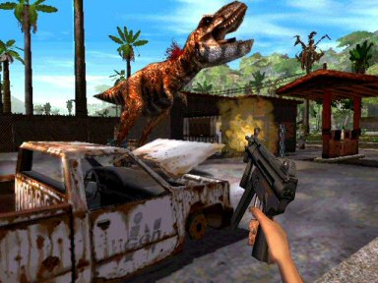
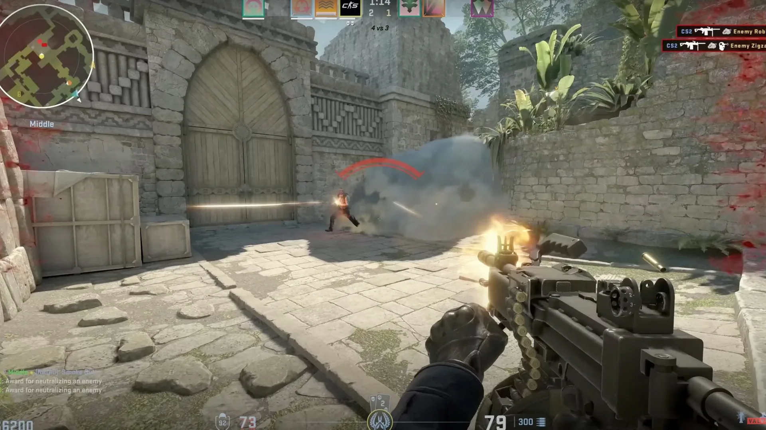
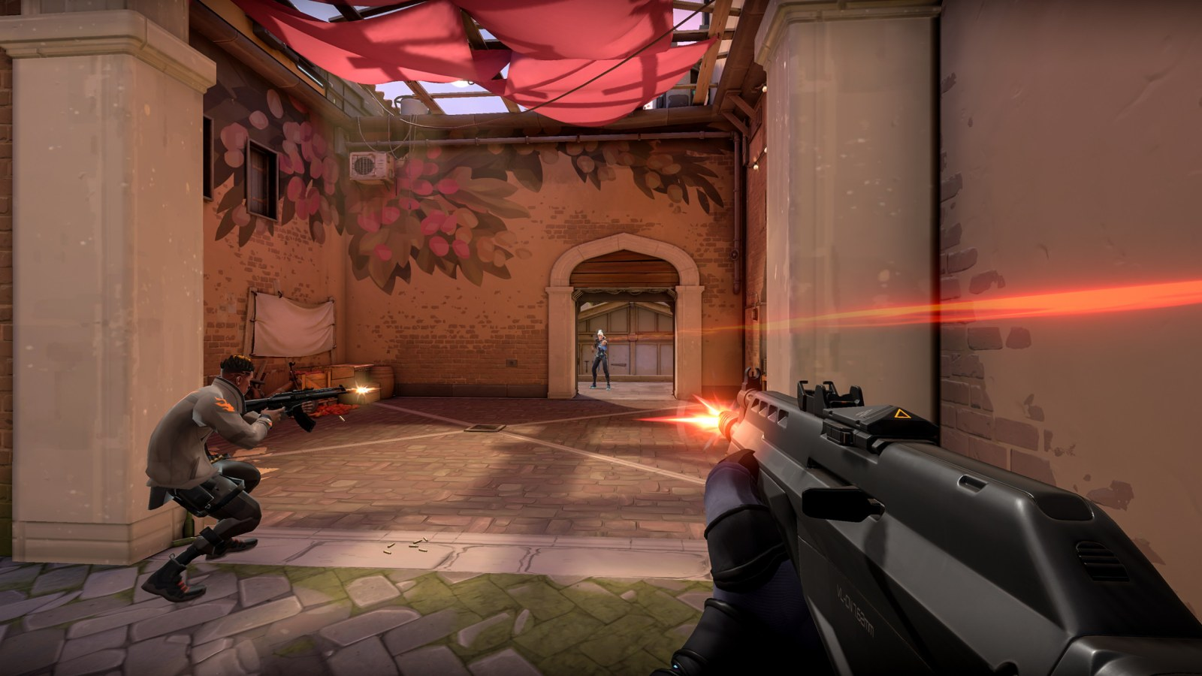
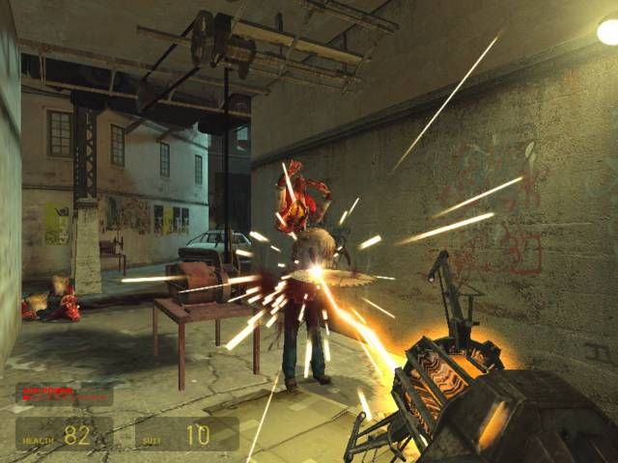
First-Person-Shooter (FPS)
As the FPS genre has evolved, different areas of focus for design have emerged:
Realistic rendering: Emulating human peripheral vision
More realistic movement/ interaction: Trespasser is a notable example of a AAA game that tried to reinvent the wheel and fell flat (largely due to its over-ambition and reliance on very powerful hardware).
Exploration: Instead of linear levels (bringing back and mixing other genres to keep FPS games fresh)
Trespasser © Electronic Arts
Half-Life 2 © Valve
Counter-Strike 2 © Valve
Valorant© Riot Games

Slide 12
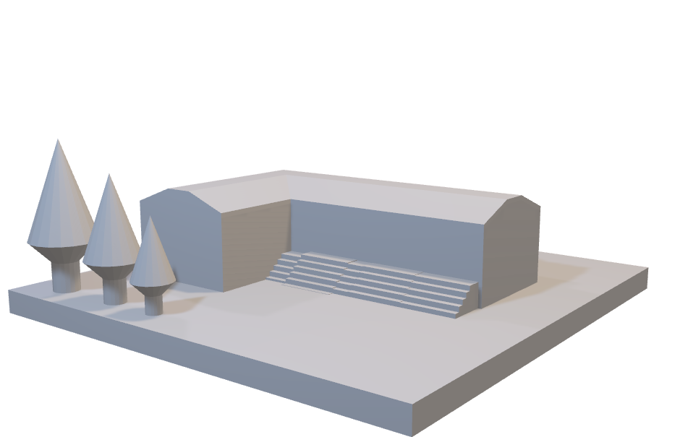
Level Design Considerations
Level design in FPS games governs many of the gameplay aspects. These are some of the factors to consider:
Level geometry/ structure – Creating a basic block-out of the level can help test this early in development.
Pick-Up placement (weapons, ammunition and health/ power-ups)
NPC placement
Script design (controlling NPCs spawning, mutable level features)
Level structure needs to take these into account:
Pacing – Levels need to be designed so that key points on the map are accessible, and obvious to the player (is there a focal point you are wanting to guide the player towards?) Are you encouraging exploration or does the player need to get around quickly?
Tension – Create levels that put the player into situations or place the player under pressure (being hunted through a dense cityscape or trapped in a room with a timer ticking down).
Challenge – The level goals need to be obvious and attainable, whilst not guaranteeing success. An unclear goal may cause frustration, too easy and the player will become bored. Remember Mihaly Chiksentimihi’s concept of Flow?

Slide 13
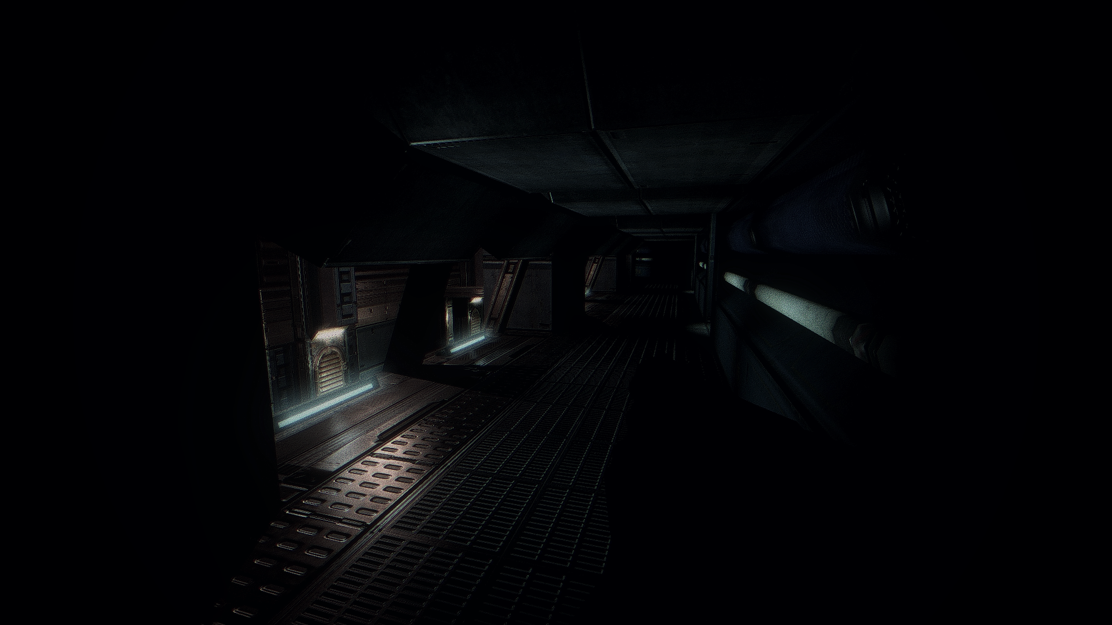
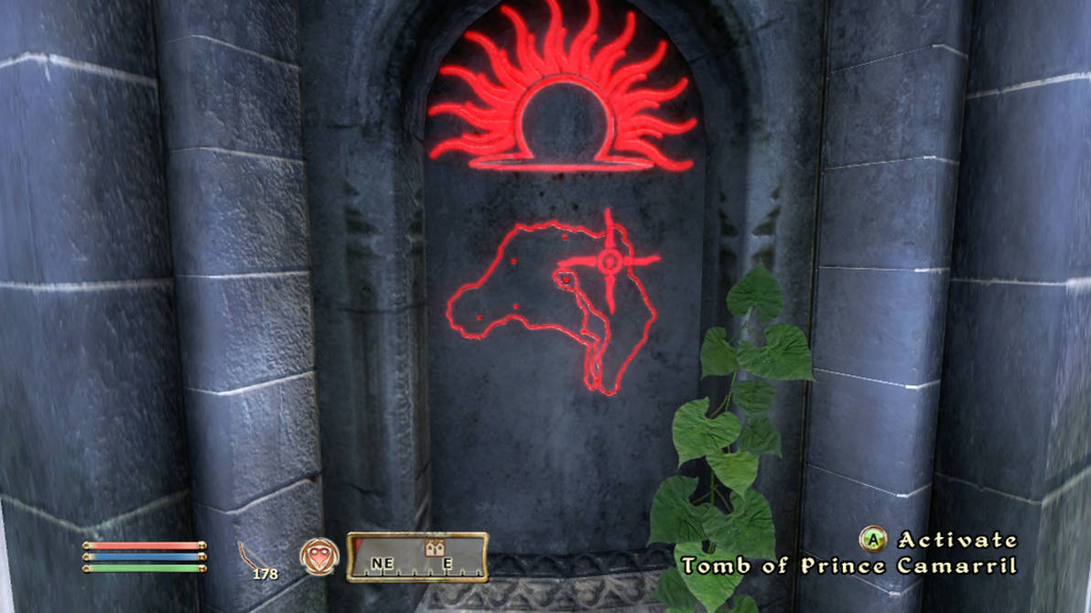
Level Design Considerations
Level segmentation is also an important aspect to consider. Here the level is split according to:
Spatial segmentation – Different parts of the level have some unique challenge or condition.
Doom 3 has a section of a level where you navigate through corridors in pitch darkness, relying on very limited light to find your way.
Some parts of heists and missions in GTA Online use darkness, stealth and the use of disguises.
It is important to ensure that your level design supports the style of gameplay. In GTA Online, if your cover is blown on a mission or a camera is triggered, you may need to fight your way through the mission. Does your level design still give the player a chance to complete it under different conditions?
Doom 3© id Software
Temporal segmentation underpins pacing. Are you allowing your player time to explore, or putting them under pressure? How long do you want them to spend in the level, and what experience are you trying to create?
Some games also use temporal segmentation to ensure that parts of the level are not available until a certain time. The Path of the Mythic Dawn quest in Elder Scrolls IV: Oblivion features a hidden entrance as part of the main story that is only available once a puzzle has been completed, and the player waits until 12pm for the entrance to be revealed.
Elder Scrolls IV: Oblivion© Bethesda Softworks

Slide 14
Level Design Considerations
Common patterns that underpin FPS level design…
Sniper positions: Elevated (typically protected) locations where players and NPCs can attack other characters using long-range weapons.
Gallery: An elevated area running parallel to a corridor where players can attack enemies below.
Choke Point: A single, narrow point of progress (a doorway) that is a focal point for an attack.
Alternate gameplay: Allow the player access to enter vehicles or gun turrets.
Split levels: Provide the player with a choice of path to follow.
Hidden area: Very popular in older FPS games – usually a secret location with health and/or ammo. May be tied to an overall level score.
Flanking route: Gives the player a chance to scope out an alternative route through a difficult region of the map and may provide a tactical advantage in terms of attacking a large group of enemies.

Slide 15
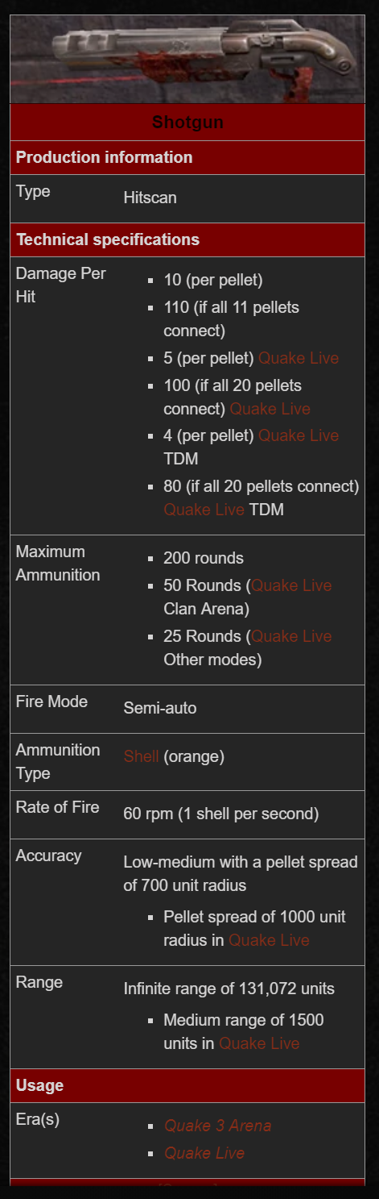
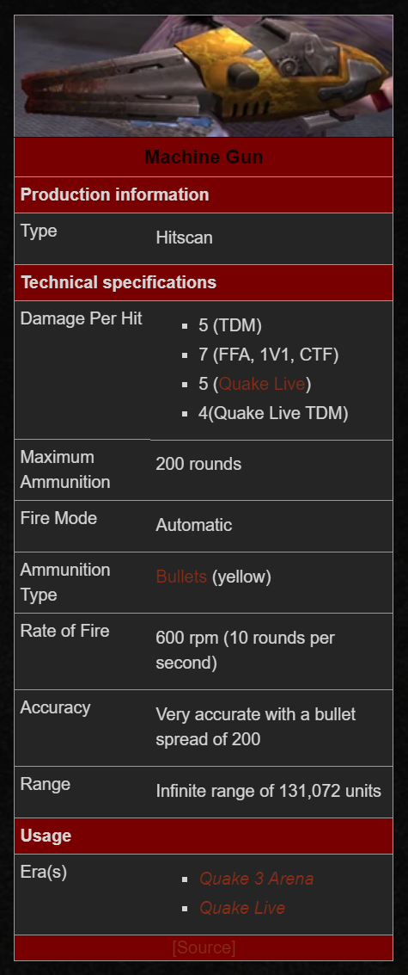
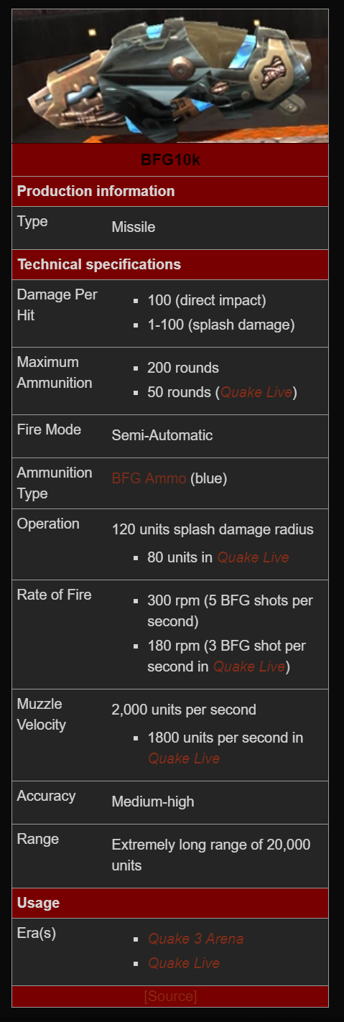
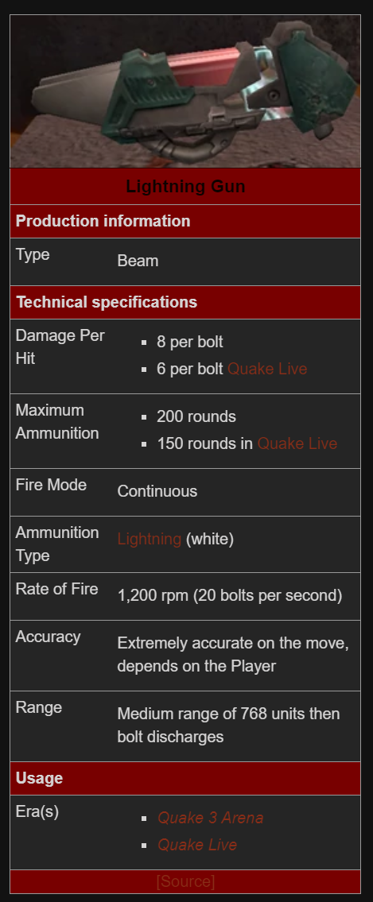
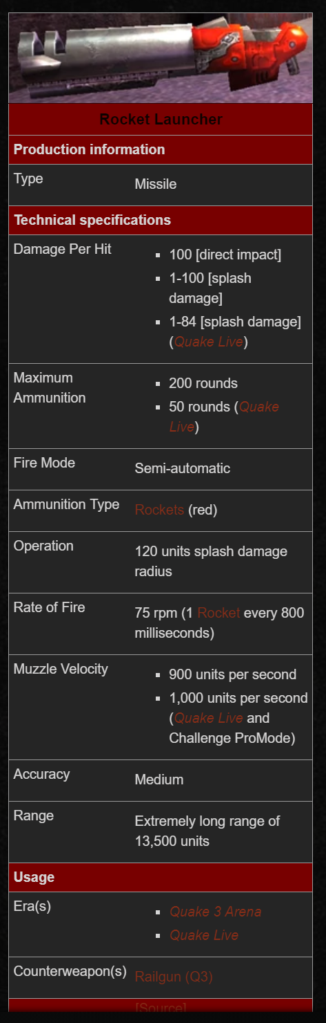
Designing Weapon and Enemy Types
This is a partial table of weapon capabilities from Quake III (http://quake.wikia.com/wiki/Category:Quake_III_Arena_weapons)

Slide 16
Designing Weapon and Enemy Types
In addition to designing each enemy, weapon, and pick-up, your design documentation should show a timeline for each item – at what point during the progression of the game it appears and how long is it in play (think a more focused version of the beat chart)?
The chart below shows the difficulty of a range of enemy types that may be encountered in the game. Visually displaying this information gives us an overview of the flow and a way of controlling the difficulty curve.

